Slide 1
CanSat 2023 Post Flight Review (PFR) Version 1.0
Team 1032
Yes we CANSAT
Presenter: Melissa Gonzalez

Slide 2
Presentation Outline
Page #​ | Presentation Section​ | Presenter(s)​
3 | Team Organization | Melissa Gonzalez
4-6 | Systems Overview | Daniel Horton, Christian Roque
7 | Concept of Operations | Jovana Markovic
8 | Sequence of Events | Daniel Horton
9-18 | Flight Data Analysis | Max Epstein, Dylan Falzone, Yashas Shivaram
19-21 | Failure Analysis | Melissa Gonzalez
22-23 | Lessons Learned | Melissa Gonzalez
Presenter: Melissa Gonzalez

Slide 3
Team Organization
Dylan Falzone
Ground station crew
Yashas Shivaram
Max Epstein
Faculty Advisor
Mission Control Officer
Cansat Crew
Daniel Horton
Jovana Markovic
Ting Dong​
Melissa Gonzalez ​
Christian Roque
Recovery Crew
Max Epstein
Christian Roque
Presenter: Melissa Gonzalez

Slide 4
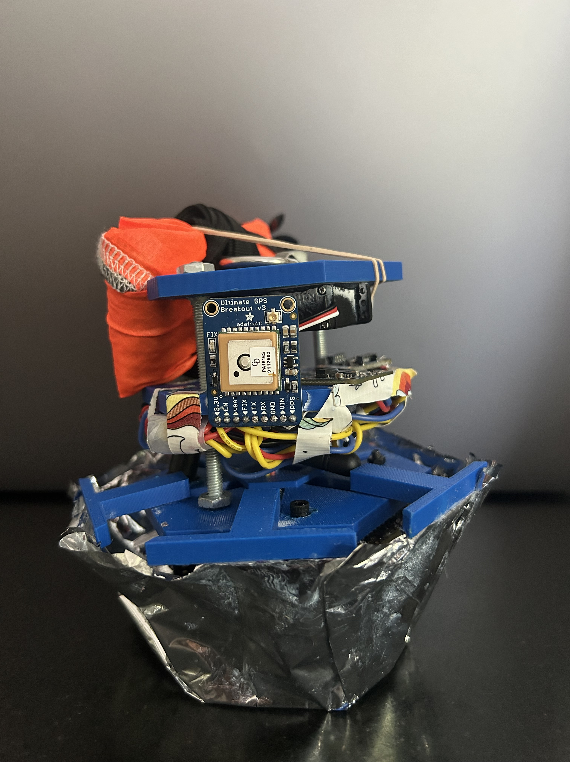
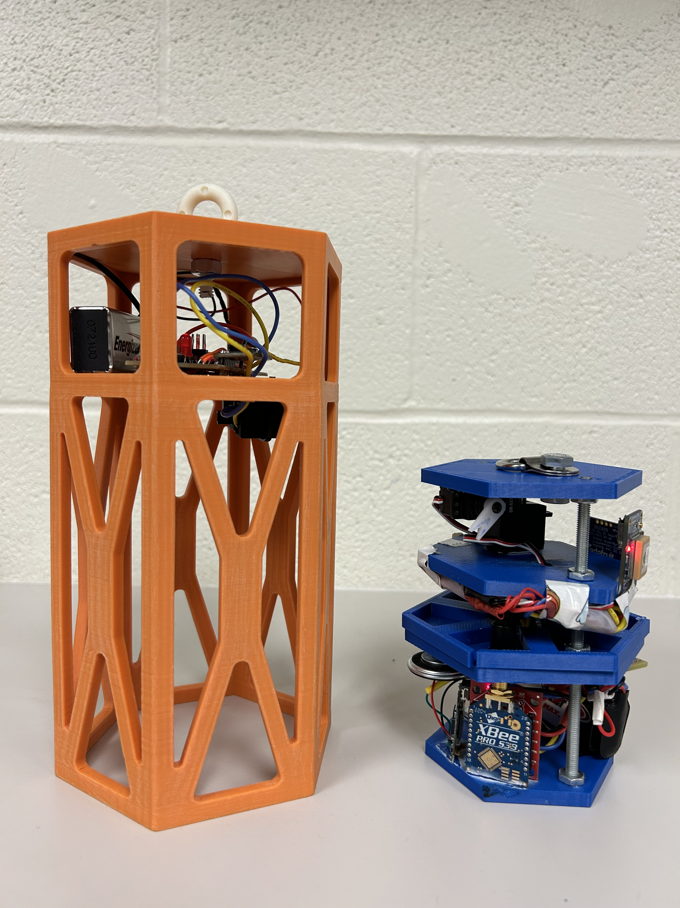
Systems Overview: Payload (1/2)
When released from the can, the payload automatically deploys a spring-loaded aerobraking heatshield.
At 200 meters, the servo motor arm rotates to release the rubber band holding the parachute in place.
Our bottom-heavy design allows the payload to passively land upright.
Presenter: Daniel Horton

Slide 5
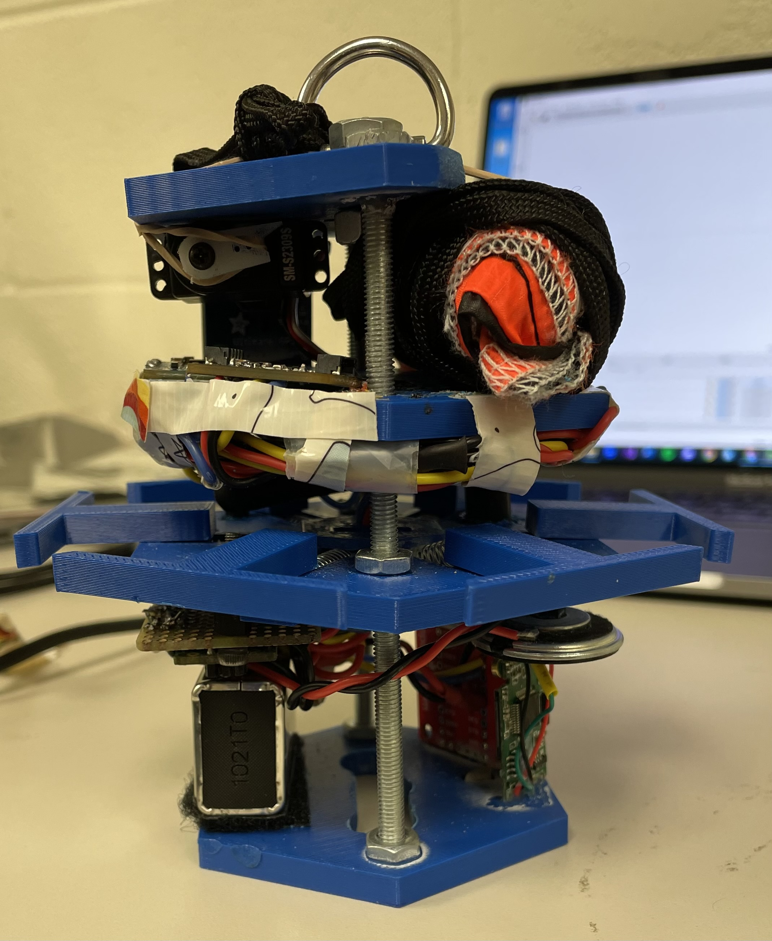
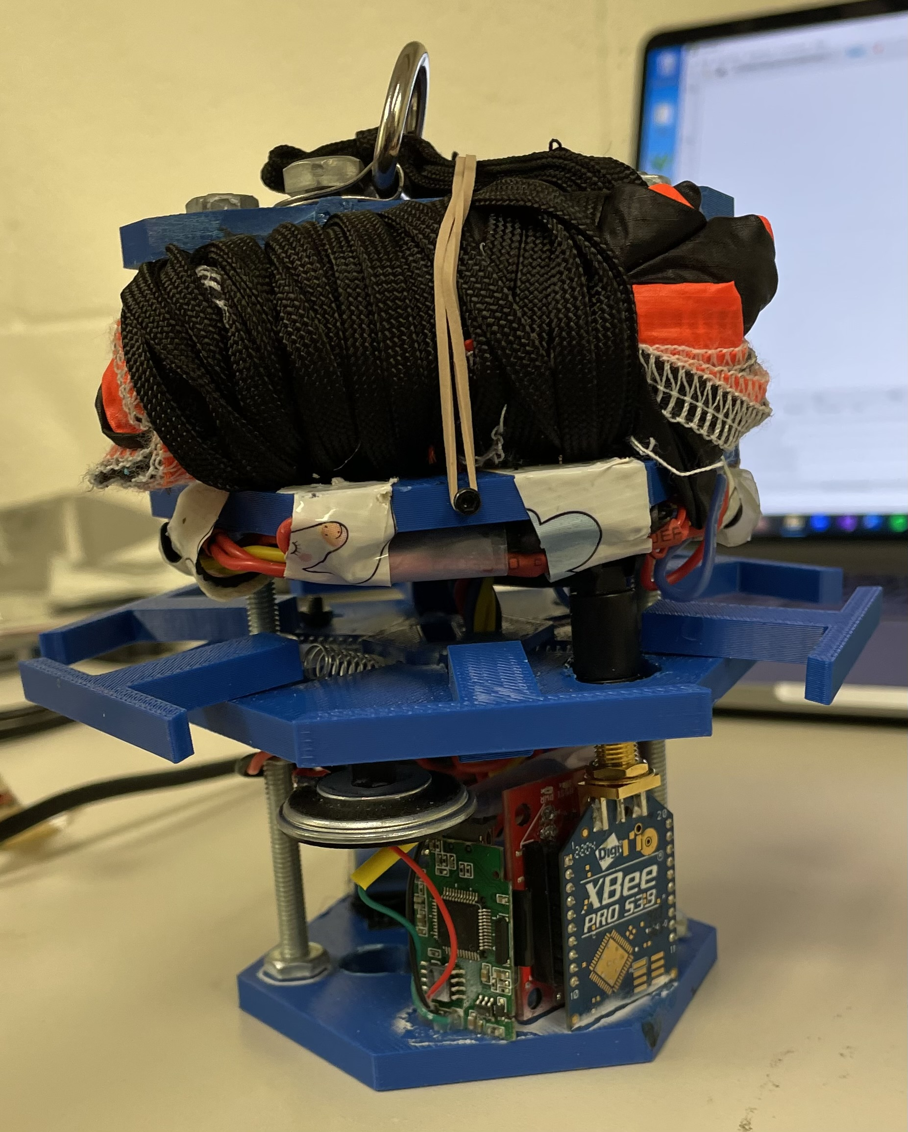
Systems Overview: Payload (2/2)
Major Components:
Electrical:
Arduino nano Microcontroller
Adafruit Ultimate GPS
Xbee Radio
BMP280 pressure/temperature sensor
BNO055 tilt sensor
Adafruit mini spy camera
Uxcell 1W speaker
Energizer 9V battery
Mechanical:
6-armed spring mechanism for the heatshield
Tie down ring for parachute and attachment to Canister
Servo Motor
Mylar heatshield (see on previous slide)
Presenter: Daniel Horton

Slide 6
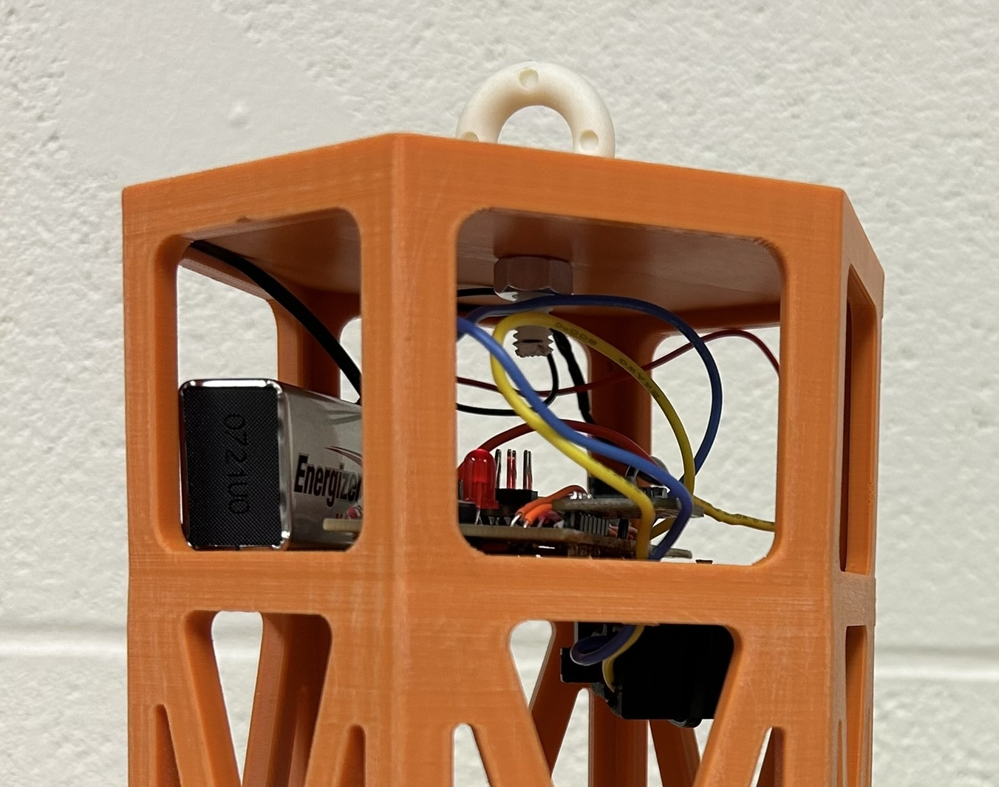
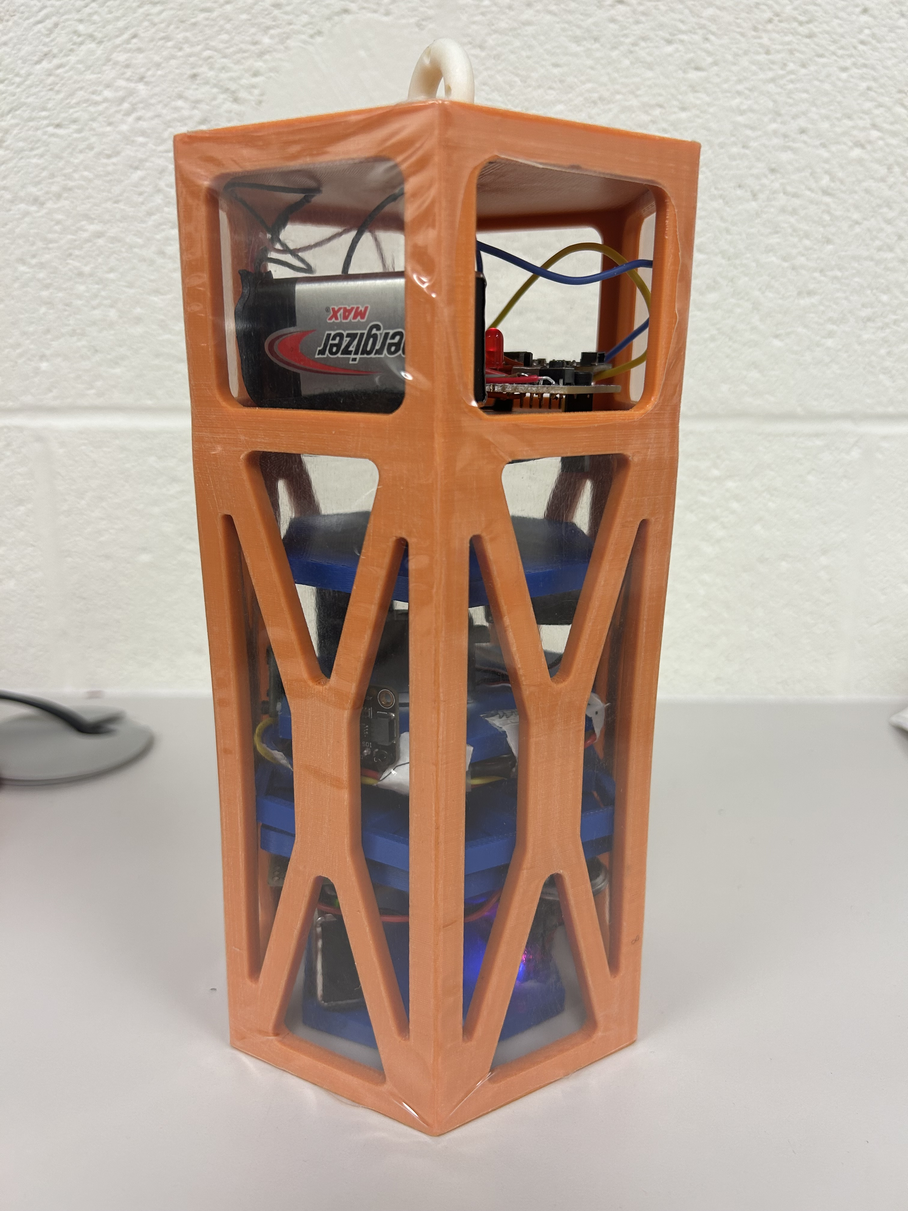
Systems Overview: Container
The can uses a linear actuator fed through the payload's parachute ring to secure it during initial descent.
At 500m, the linear actuator retracts, deploying the payload.
Major Components:
Electrical:
Energizer 9V Battery
BMP280 Pressure Sensor
Arduino Nano
Mechanical:
Linear Actuator
Fiberglass eyebolt
Shrink Wrap
Presenter: Christian Roque

Slide 7
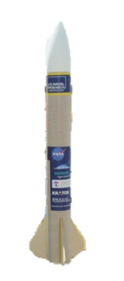

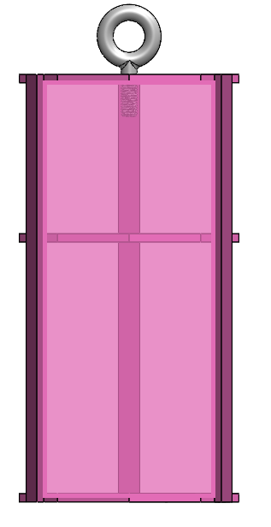
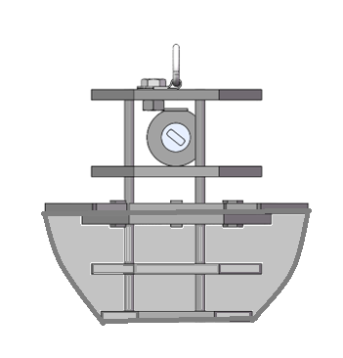
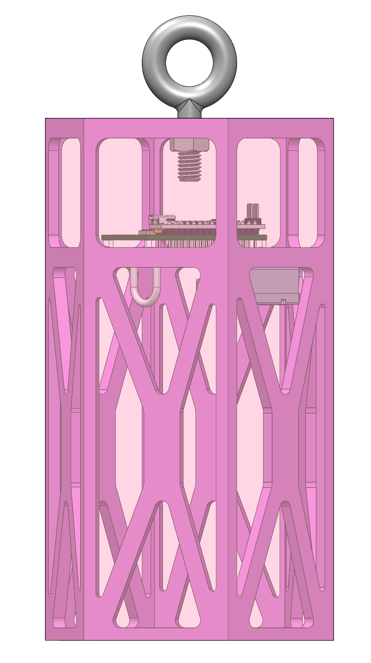
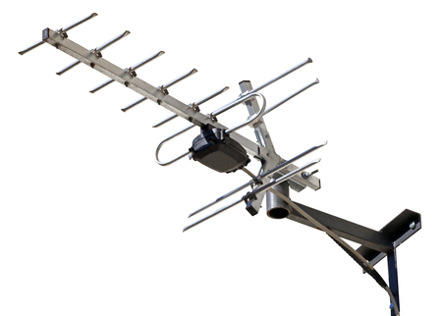


Concept of Operations
Set up ground station
Power on CanSat
Place CanSat into rocket
Rocket is launched
At 670-725m the CanSat separates and parachute opens
At 500m a probe will be released from the CanSat, which will deploy an aerobraking heat shield, with a camera facing the ground at all times
At 200m the probe will deploy a parachute too reduce descent rate
Probe will land upright
Probe will deploy a flag 500mm above the base of the probe
Recovery crew tracks and collects CanSat
FSW obtains and saves flight data & video recording to thumb drive
5
6
4
7
2
3
1
11
9
8
10
Presenter: Jovana Markovic

Slide 8
Sequence of Events
Planned Sequence | Field Operations
Check-in and weigh CanSat | Successful
Load CanSat into rocket and place on launch stand | Successful
Set up GS and send calibration command to CanSat | Successful
Launch | Successful
CanSat separation from rocket at apogee | Successful
CanSat deploys parachute, slowing descent to 15 +/- 5 m/s | Successful
At 500m, deploy the probe from the canister | Failure
Payload deploys aerobraking heatshield and descends at 20 m/s or less | —
At 200m, servo deploys the payload parachute, slowing descent to 5 +/- 1 m/s | Parachute successfully deployed, but Payload never separated from the canister
Payload lands upright | —
Flag is deployed | Failure, Did not attempt.
Buzzer is activated and the CanSat is recovered | Successful
Telemetry is saved to .csv and thumb drive is submitted | Successful
Descent video is recovered from camera microSD | Failure, video files corrupted
Presenter: Daniel Horton

Slide 9
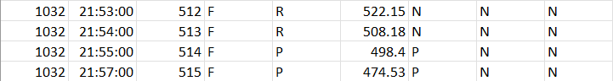
Flight Data Analysis (1/10)
Payload was not released from the can during descent
The linear actuator holding the payload in place did not retract, keeping the payload inside the can
State Change from Rocket Separation to Payload Deployment
Presenter: Dylan Falzone

Slide 10
Flight Data Analysis (2/10)
The heat shield was not deployed since the payload was never released from the canister
Had the payload been released from the can, the spring-loaded heat shield would have deployed automatically
State Change from no Heatshield Deployment to Heatshield Deployment
Presenter: Dylan Falzone

Slide 11
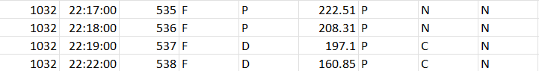
Flight Data Analysis (3/10)
Parachute deployment system allowed the parachute to release when the altitude reached 200 meters
The servo motor rotated, releasing the rubber band and deploying the parachute, but the payload remained stuck in the canister.
State Change from no Parachute Deployment to Parachute
Deployment
Presenter: Dylan Falzone

Slide 12
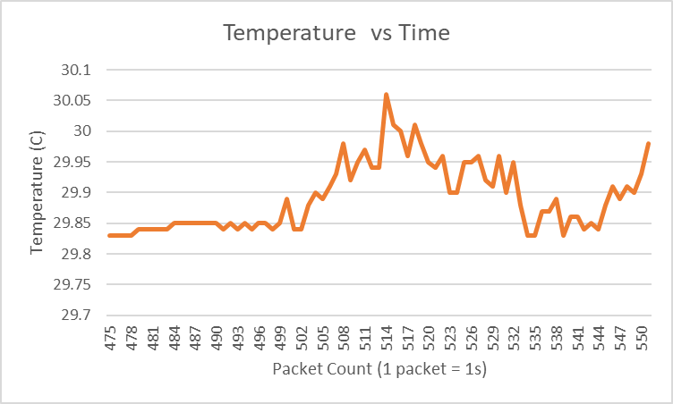
Flight Data Analysis (4/10)
Presenter: Max Epstein

Slide 13
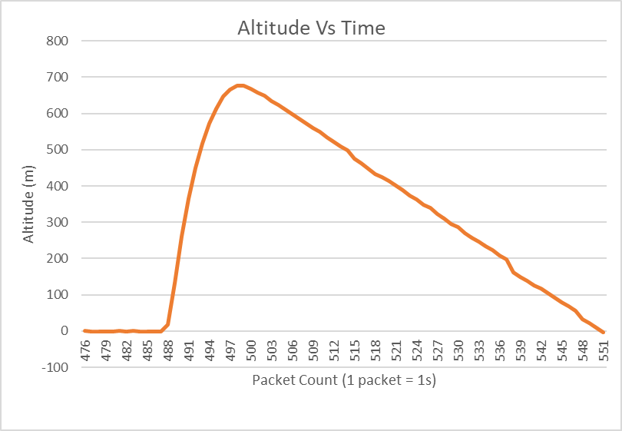
Flight Data Analysis (5/10)
Presenter: Max Epstein

Slide 14
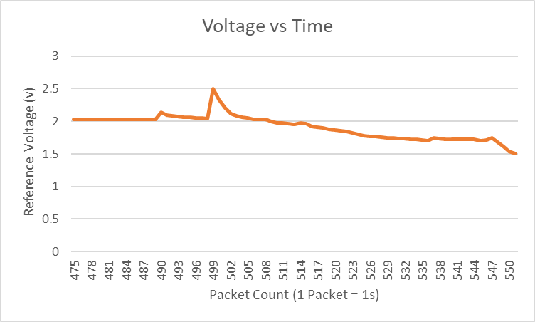
Flight Data Analysis (6/10)
Presenter: Max Epstein

Slide 15
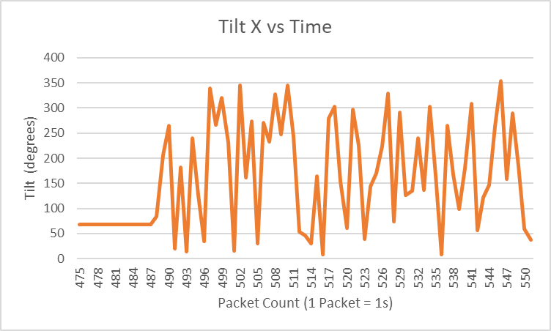
Flight Data Analysis (7/10)
Presenter: Max Epstein

Slide 16
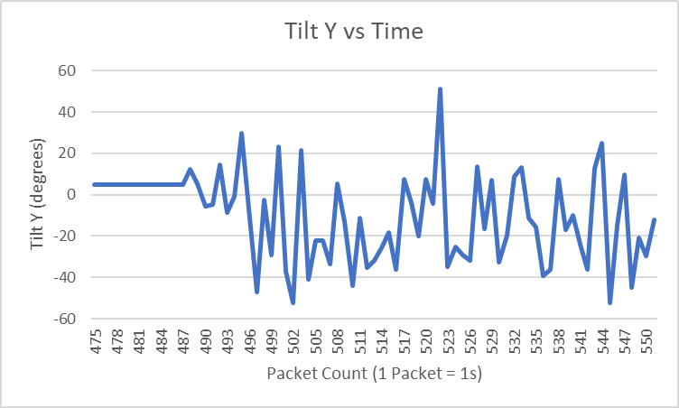
Flight Data Analysis (8/10)
Presenter: Max Epstein

Slide 17
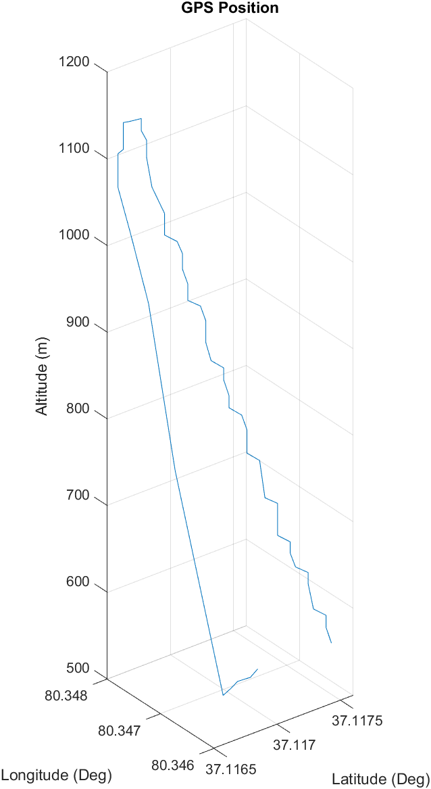
Flight Data Analysis (9/10)
Presenter: Yashas Shivaram

Slide 18
Flight Data Analysis (10/10)
During flight the payload camera was activated as expected, but upon recovery, the video files were corrupted and unviewable.
The bonus camera objective was not attempted.
Presenter: Yashas Shivaram

Slide 19
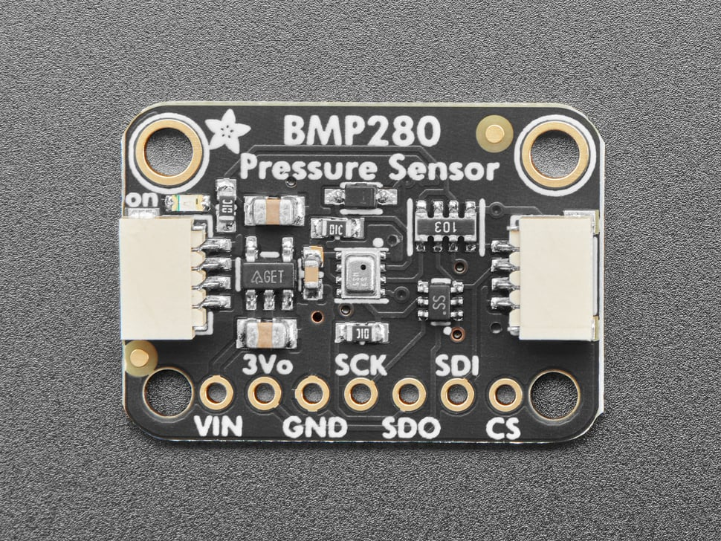
Failure Analysis (1/3)
Separation failure:
Failure: the payload did not separate from the container resulting in the entire CanSat impacting the ground at once.
Root Cause: The container's altitude value did not exceed 670m, the hardcoded threshold for apogee. As a result, the linear actuator was not retracted, and the payload was not released.
Corrective Actions: Calibrating the container at the launch pad instead of the tents, lowering the expected apogee below the given value, or not hardcoding a value at all.
Presenter: Melissa Gonzalez

Slide 20
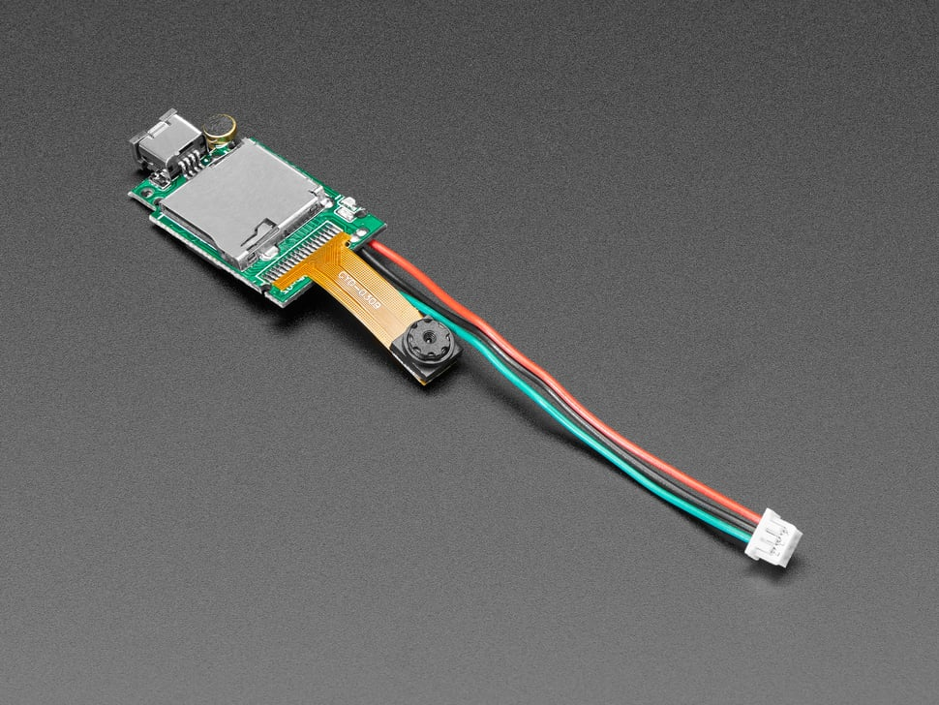
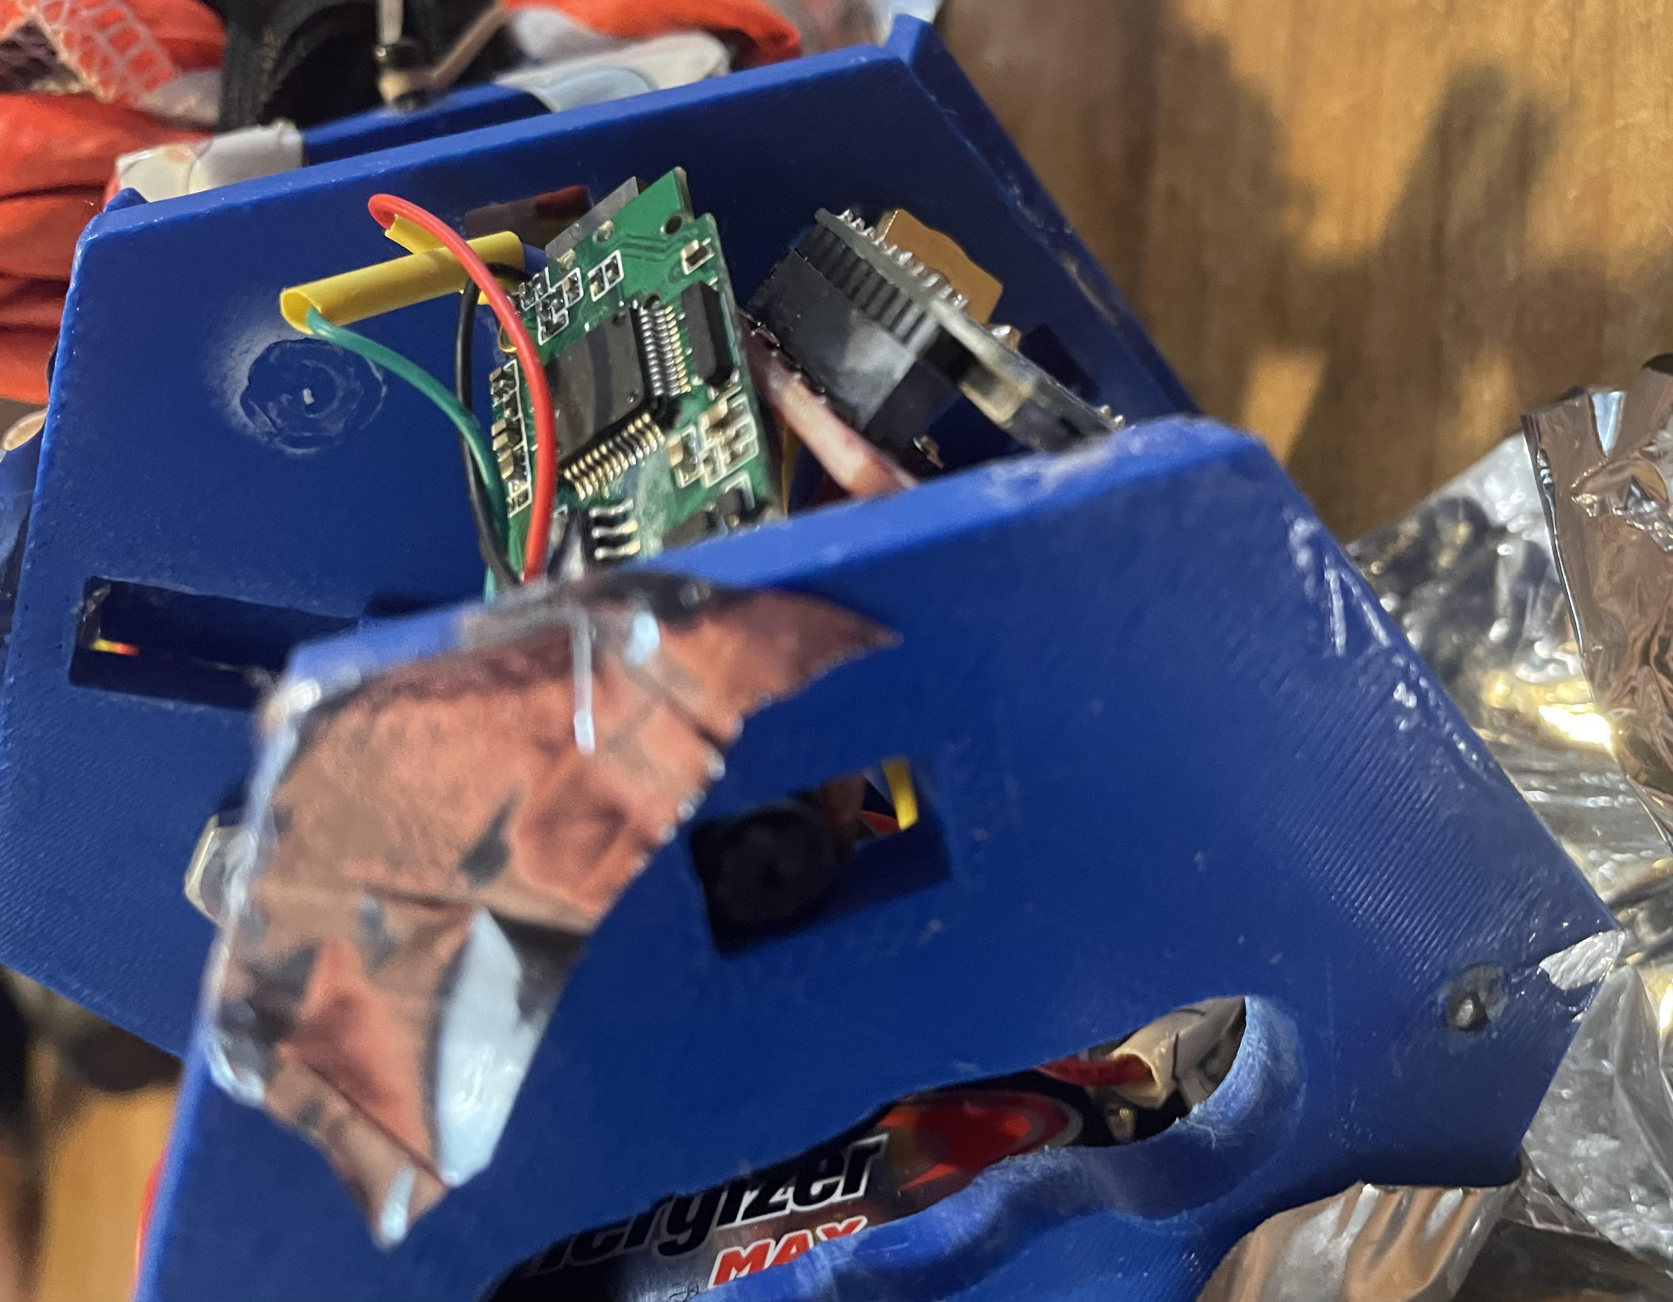
Failure Analysis (2/3)
Camera failure:
Failure: The payload camera was properly activated and deactivated as intended, however, the AVI (video) files it saved to the microSD card became corrupted.
Root Cause: Unknown, potentially excess heat in soldering, or the force from impact.
Corrective Actions: Begin component selection earlier to ensure reliability.
Presenter: Melissa Gonzalez

Slide 21
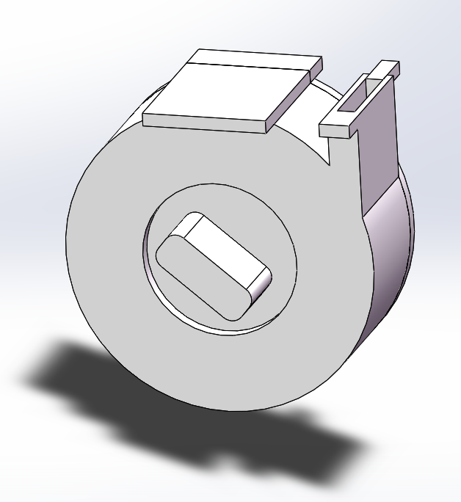
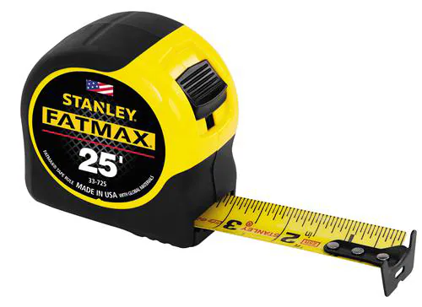
Failure Analysis (3/3)
Flag Mechanism failure:
Failure: The flag mechanism was so heavy that it had to be removed from the payload to ensure it was within required weight.
Root Cause: The use of a clock spring and a tape measure made it significantly heavy.
Corrective Actions: Design a lighter mechanism.
Presenter: Melissa Gonzalez

Slide 22
Lessons Learned (1/2)
What worked:
Accurate telemetry data received throughout flight
Canister parachute slowed descent within accepted range
Audio beacon activated upon landing
Payload parachute mechanism would have worked as intended
Canister, payload, and electronics were all mostly intact upon landing
What didn't:
Flag mechanism not implemented due to complications and weight constraints
Video files saved to the microSD were corrupted
Container and payload failed to separate during flight
Presenter: Melissa Gonzalez

Slide 23
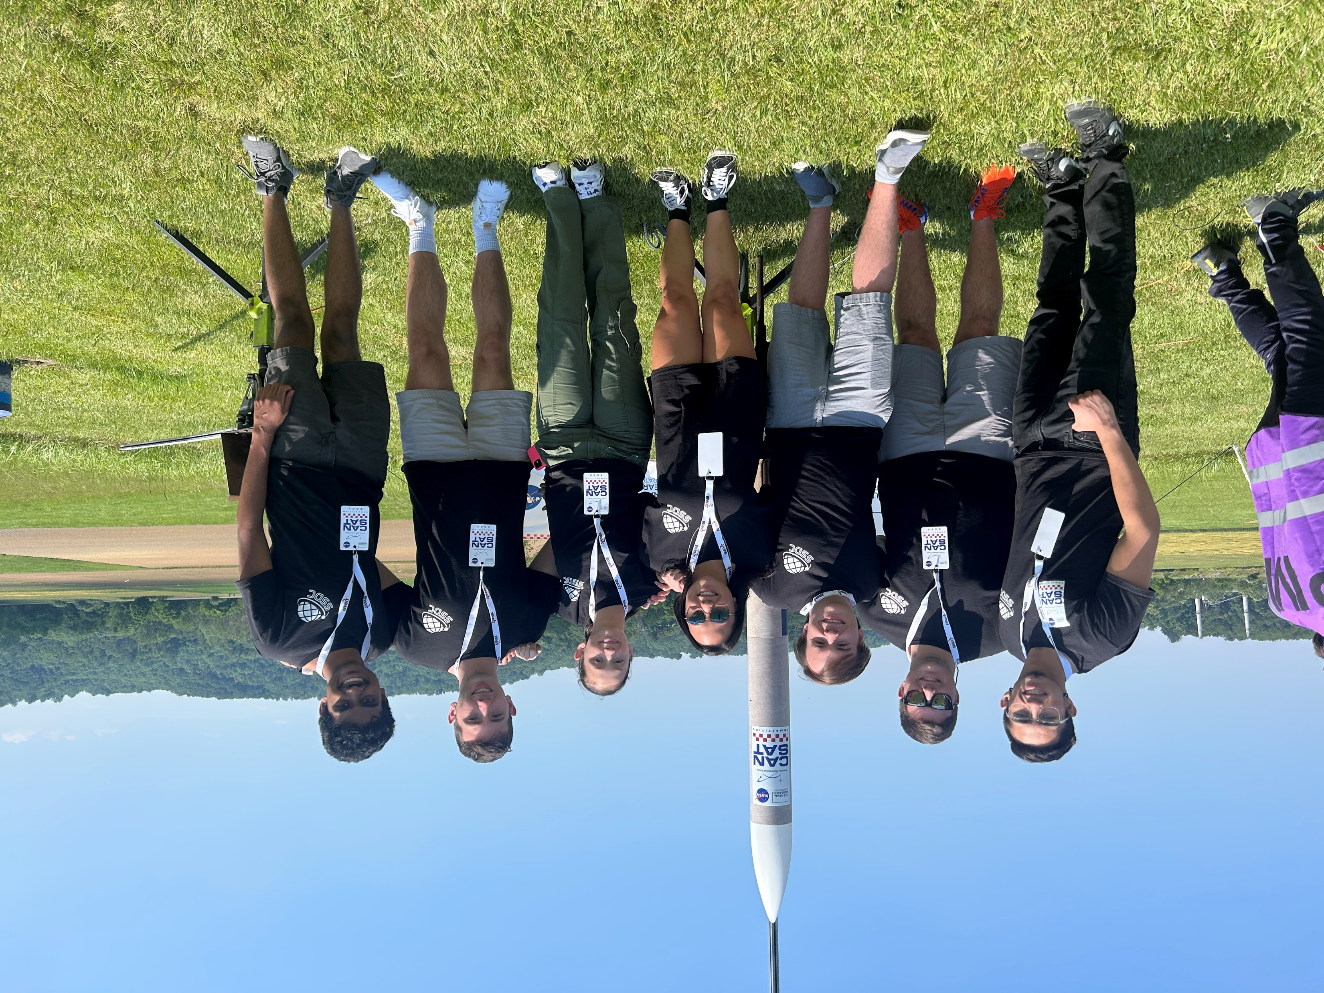
Lessons Learned (2/2)
Conclusions:
Order parts sooner to protect against supply chain issues.
Proper time management, especially in the manufacturing process is critical
Code can be more effective if memory use is managed properly.
Overall, we think we did well for our first attempt at competition!
Presenter: Melissa Gonzalez

